Slide 1


House Price Prediction
Sriudaya Damuluri, Dilip Molugu, Navya Mote, Nikhil Reddy, Luyao Shen, Xin Zhang

Slide 2
Problem Outlining
Problems faced by new house buyers.
Factors influencing the sale price.
Cleaning and preprocessing the data.
Applying various modelling techniques.
Comparing all the models to determine the best.
Predicting the sale prices of house in $.

Slide 3

1. The sources of the data sets.
House Prices from Kaggle
https://www.kaggle.com/c/house-prices-advanced-regression-techniques
20 continuous variables related to various area dimensions
14 discrete variables typically quantify the number of items occurring within the house
23 nominal and 23 ordinal variables that range from 2 to 28 classes
The nominal variables identify various types of dwellings, garages, materials, and environmental conditions
The ordinal variables rate various items within the property.

Slide 4
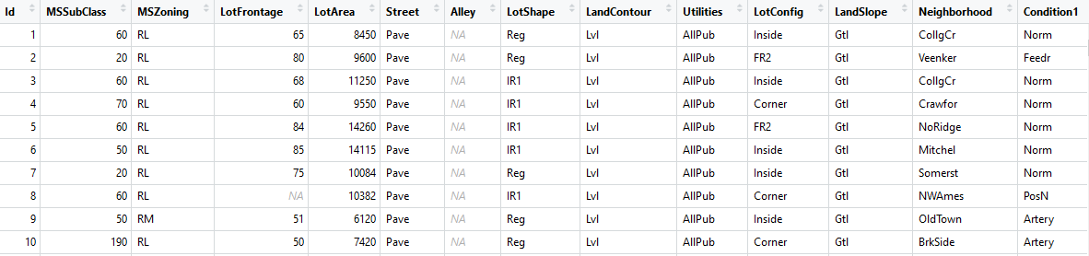
Subset of Data Set
Source: https://www.kaggle.com/c/house-prices-advanced-regression-techniques

Slide 5
Variable Identification
Response Variable
Sale Price
Important Predictors:
OverallQual
Neighborhood
GrLivArea
TotRmsAbvGrd (Total number of rooms)
YearBuilt
Garage Area
Bathrooms

Slide 6
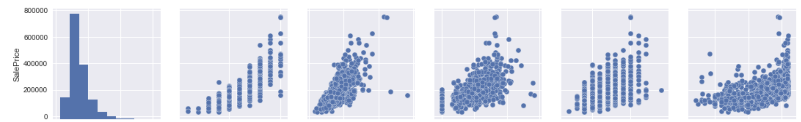
Comparing the sale price with important predictors

Slide 7
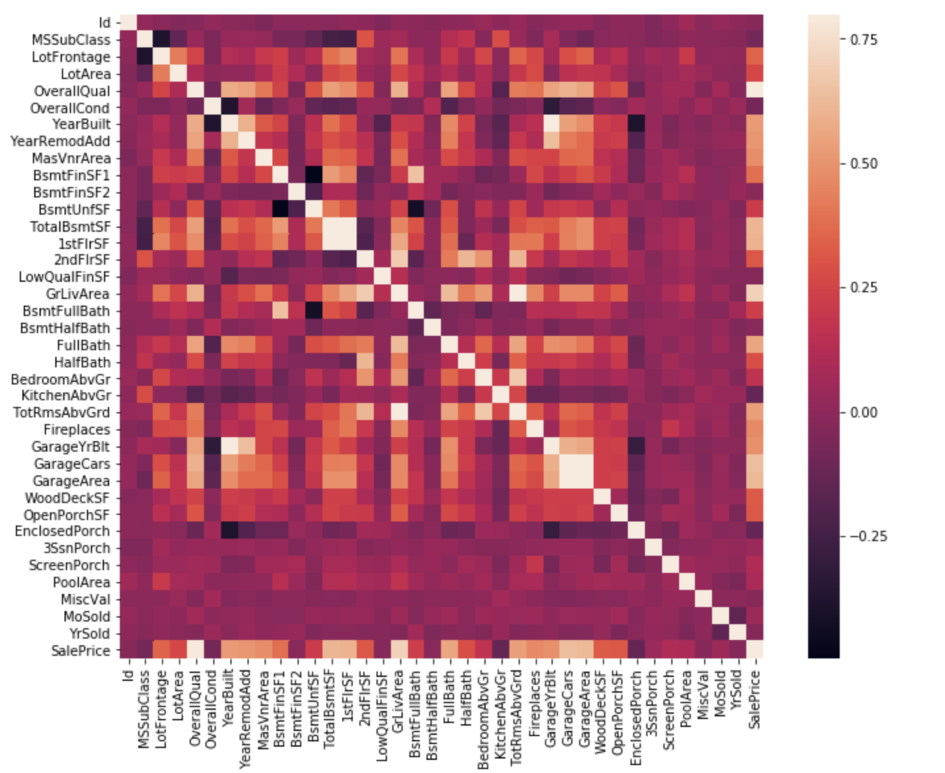
Heat map
A heatmap to understand the correlation between various predictors.
By looking at this heatmap we can eliminate the multicollinearity in the data; by eliminating one of the predictor which is less correlated with the sale price.
Year built and garage year built
Garage living area and total room above ground
Garage area and garage cars

Slide 8
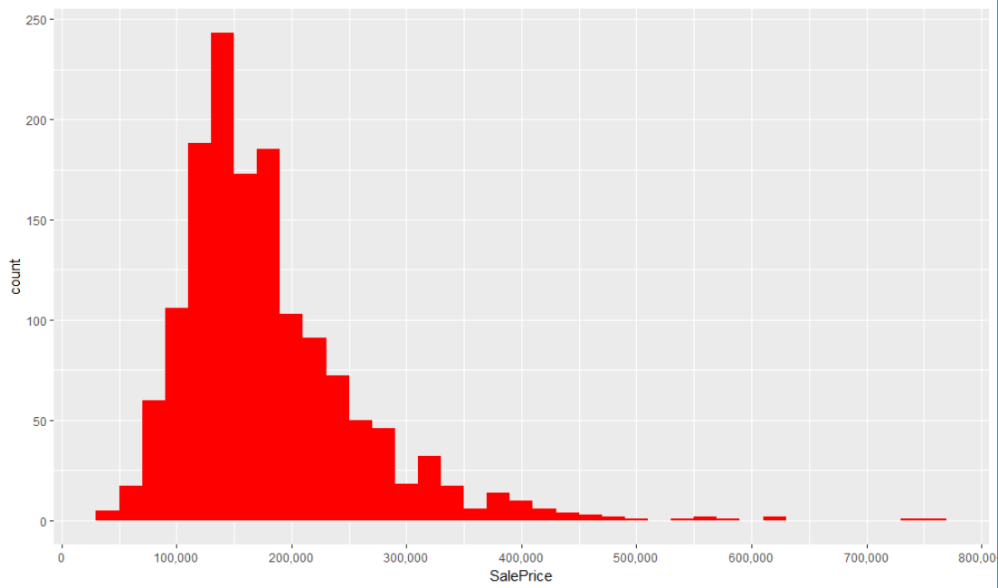
Sale Price
We can observe that the data is right skewed and not normally distributed.
Skewness- 1.882876

Slide 9
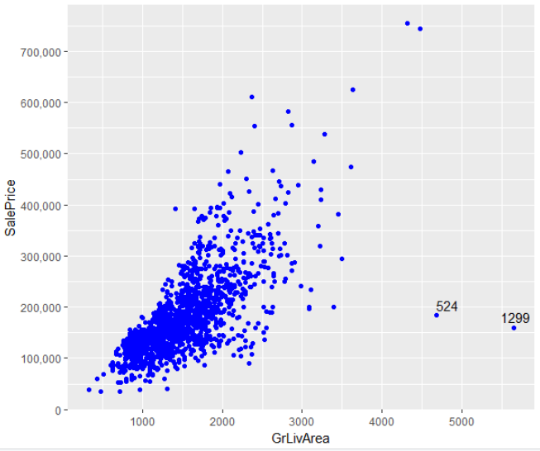
SalePrice vs GrLivArea
We observe that the GrLivArea is positively related to SalePrice.
However we can observe two outliers which has more area but has less saleprice.

Slide 10
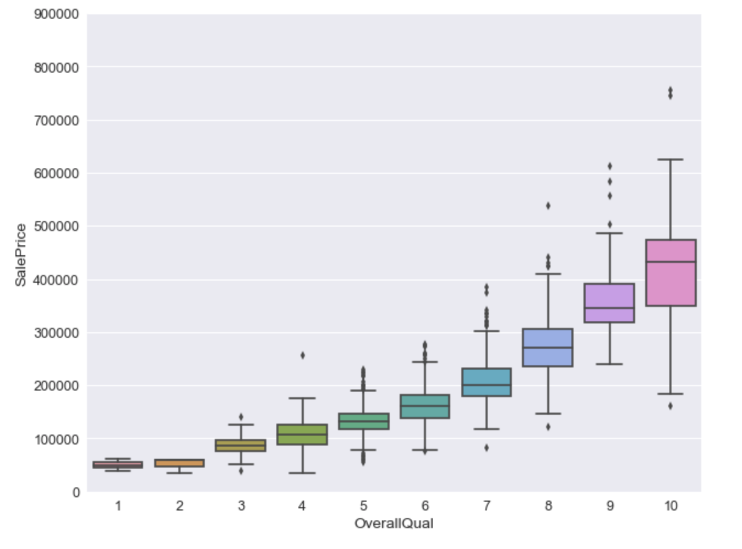
SalePrice vs OverallQual
The SalePrice increases with increase in OverallQual.
Positively Correlated.

Slide 11
Raw Data Pre-Processing
Dealing with Missing Values.
Dealing with skewness in the predictors.
Dealing with Outliers.
Binning few categorical variables.
Introducing new predictors from the raw data.
Feature Extraction.

Slide 12
Dealing with missing data
PoolQC (2909)
MiscFeature (2814)
Alley (2721)
Fence (2348)
SalePrice (1459)
FireplaceQu (1420)
LotFrontage (486)
GarageYrBlt (159)
GarageFinish (159)
GarageQual (159)
GarageCond (159)
GarageType (157)
BsmtCond (82)
BsmtExposure (82)
BsmtQua l(81)
BsmtFinType2(80)
BsmtFinType1(79)
MasVnrType(24)
MasVnrArea(23)
MSZoning(4)
Utilities(2)
BsmtFullBath(2)
BsmtHalfBath(2)
Functional(2)
Exterior1st(1)
Exterior2nd (1)
BsmtFinSF1 (1)
BsmtFinSF2 (1)
BsmtUnfSF (1)
TotalBsmtSF (1)
Electrical(1)
KitchenQual(1)
GarageCars(1)
GarageArea(1)
SaleType(1)

Slide 13
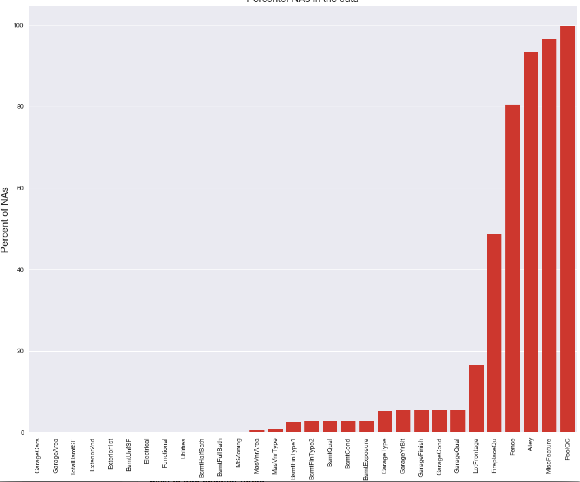
Bar Graph representing NA’s

Slide 14
Dealing with missing data and cleaning
Identify missing values with most number of NA’s.
Deal with predictors that contain the missing values by imputing values, or by removing the predictor or the entries, or by predicting the missing values using other correlated predictors.
Convert categorical variables into ordinal integers or factors depending on the ordinality.

Slide 15
Imputing the missing values
Most of the missing values were replaced with None. for predictors like PoolQC, MiscFeature etc.
Converted character variables into ordinal integers depending on the ordinality.
Predicted the pool quality(PoolQc) with the help of the PoolArea.
Imputed some of the missing values using mode or median imputation by choosing which ever is best.
Removing the predictor LotFrontage and FireplaceQu has given better results than imputing the NAs in the predictor.

Slide 16
Pre processing of the data.
Removed the outliers- removing the observations which had high living area but had relatively low sale price.
Performed centering and scaling on the numeric data.
Used Log transformation to reduce the skewness in the sale price. (Skewness after the transformation 0.1213)
Removed the columns with low variance using the near zero variance function.

Slide 17
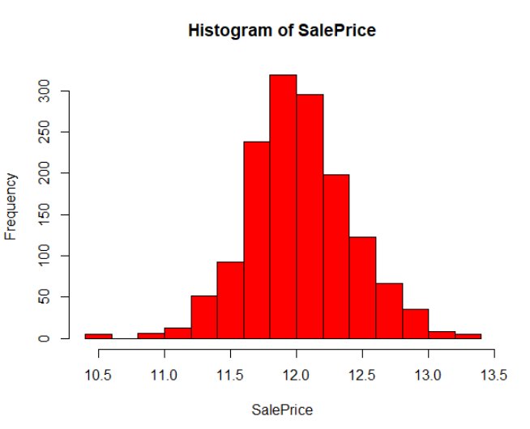
SalePrice after log transformation.

Slide 18
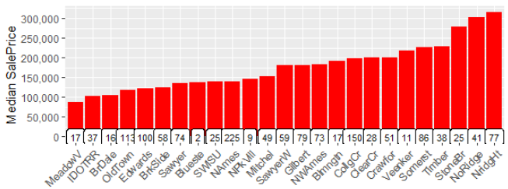
PreProcess - Neighborhood binning
Created bins with similar median sale prices from the above graph.

Slide 19
Derived variables
Remodelled? - Created dummy variables from year built and year remodelled.
Calculated age using year sold and year remodelled.
Isnew? Determined if a house is new or not, if year sold = year built.
Created a new variable for bathrooms- all$TotBathrooms <- all$FullBath + (all$HalfBath*0.5) + all$BsmtFullBath + (all$BsmtHalfBath*0.5)
Calculated the total squarefeet of the house from various area variables.
Totalporsh- combining all the porsh area-
all$TotalPorchSF <- all$OpenPorchSF + all$EnclosedPorch + all$X3SsnPorch + all$ScreenPorch

Slide 20
Removing Multicollinearity
Removed the following variables with multicollinearity and has less correlation with SalePrice:
'YearRemodAdd', 'GarageYrBlt', 'GarageArea', 'GarageCond', 'TotalBsmtSF', 'TotalRmsAbvGrd', 'BsmtFinSF1'

Slide 21
Final Cleaned Data Summary
The final cleaned data has 161 predictors out of which we have 66 numeric variables and 95 dummy variables.

Slide 22
Linear Predictive models Used.
Simple LR with all predictors
lmFitAllPredictors = lm(SalePrice~.,data = xt_train)
LR with Filtered predictors and 10 folds CV
ctrl <- trainControl(method = "cv", number = 10)
lmFiltered <- train(x = trainXfiltered, y = y_train, method = "lm", trControl = ctrl)
Robust linear regression with preprocess by PCA
rlmPCA <- train(trainXfiltered, y_train,method = "rlm",preProcess = "pca",trControl = ctrl)
intercept psi RMSE Rsquared MAE
TRUE psi.huber 0.1210021 0.9075679 0.08539670
PLS with 10 folds CV
plsTune <- train(trainXfiltered, y_train,method = "pls",tuneLength = 20,trControl = ctrl,preProc = c("center", "scale"))
ncomp RMSE Rsquared MAE
20 0.1125119 0.9191268 0.07807964
PCR with 10 folds CV
pcrTune <- train(x = x_train, y = y_train, method = "pcr", tuneGrid = expand.grid(ncomp = 1:35), trControl = ctrl)
35 0.1258376 0.8996198 0.09012689
Ridge regression
ridgeGrid <- data.frame(.lambda = seq(0, .1, length = 15))
ridgeRegFit <- train(x_train, y_train,method = "ridge",tuneGrid = ridgeGrid,trControl = ctrl,preProc = c("center", "scale"))
enet
enetGrid <- expand.grid(.lambda = c(0, 0.01, .1),.fraction = seq(.05, 1, length = 20))
enetTune <- train(trainXfiltered, y_train,method = "enet",tuneGrid = enetGrid,trControl = ctrl, preProc = c("center", "scale"))

Slide 23
Non-Linear Predictive models Used.
MARS:-
marsGrid = expand.grid(.degree=1:2, .nprune=2:38)
marsModel = train(x=train2[,-c(1,3,164)], y=train2$SalePrice, method="earth", tuneGrid=marsGrid, trControl = modelcontrol, preProc = pprocess)
Optimal rmse found at nprune = 29, degree = 1
SVM:-
svmRModel = train(x=train2[,-c(1,3,164)], y=train2$SalePrice, method="svmRadial", tuneLength=20, trControl = modelcontrol, preProc= pprocess)
Optimal rmse found at sigma = 0.003434621 and C = 2
NeuralNet:-
nnGrid = expand.grid( .decay=c(0.1, 0.5), .size=1:10 )
nnetModel = train(x=train2[,-c(1,3,164)], y=train2$SalePrice, method="nnet", linout=TRUE, trace=FALSE, MaxNWts=5 * (ncol(train1)+1) + 5 + 1, maxit=100, tuneGrid = nnGrid)
Optimal rmse for the model at size = 1 and decay = 0.5.
K-Nearest neighbours:-
knnModel = train(x=train2[,-c(1,3,164)], y=train2$SalePrice, method="knn",preProc=pprocess, tuneLength=10, trControl = modelcontrol)
Optimal rmse found at k = 11

Slide 24
Performance Results (Linear models):-
Model | Train RMSE | R^2 | RMSE SD | R^2 SD | Test RMSE
Simple LR with all predictors | 0.1051 | Multiple R-squared: 0.9361 Adjusted R-squared: 0.9296 | - | - | 0.12194
LR with Filtered predictors and 10 folds CV | 0.1136437 | 0.9178849 | 0.01434768 | 0.01812518 | 0.12213
Robust linear regression with preprocess by PCA | 0.1214247 | 0.9067821 | 0.0157479 | 0.0206483 | 0.13200
PLS with 10 folds CV | 0.1129088 | 0.9190028 | 0.01417026 | 0.01789867 | 0.11948
PCR with 10 folds CV | 0.1253336 | 0.9006500 | 0.01507845 | 0.02140115 | 0.13939
Ridge regression | 0.1132245 | 0.9193909 | 0.01462485 | 0.01871446 | 0.12104
enet | 0.1117415 | 0.9207078 | 0.01414406 | 0.01713948 | 0.12006
Ensemble (PLS Tune and Enet) |  |  |  |  | 0.11851

Slide 25
Performance Results (Non-Linear models):-
SVM:
train rmse- 0.1144903
R2- 0.9172020
rmse sd- 0.01609515
r2 sd- 0.01847050
test rmse - 0.12514
NeuralNet:
train rmse- 0.14214997
R2- 0.87188019
rmse sd- 0.02358615
R2 sd- 0.05287173
test rmse - 0.17189
MARS:
train rmse -0.1234156
R2- 0.9038630
rmse sd - 0.01470856
R2 sd- 0.01928990
test rmse - 0.12590
K-Nearest Neighbours:
train rmse -0.1561424
R2- 0.8201765
rmse sd- 0.01640890
R2 sd- 0.03530723
test rmse - 0.17713

Slide 26
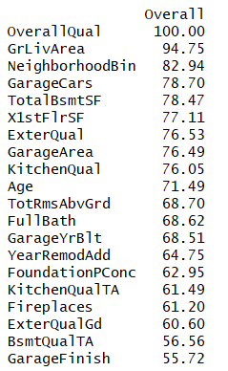
20 most important predictors:

Slide 27
Model vs Human Predictor Importance
The predictors found to be important by the models agree with what we believed to be important.
There are few additional predictors that the model found to be more important that we didn’t.

Slide 28
Thanks!
Any questions ?

